Slide 1
Interactive AC Load
Control Solution
Embedded System Design – ECEN5613
Dr. Linden McClure
Team Members: Divyesh Patel | Ruchit Naik

Slide 2
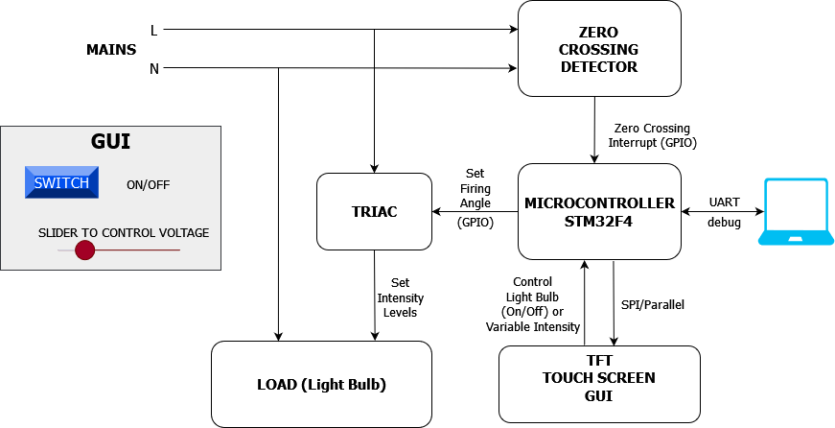
Work Done / Working features
HMI User Interface to control AC bulb brightness.
ZCD detection on low voltage AC supply (tested on 10Vpp 60Hz wave from function generator).
TRIAC control by PWM based trigger on TRIAC trigger pin.
Serial Control of brightness using UART.

Slide 3
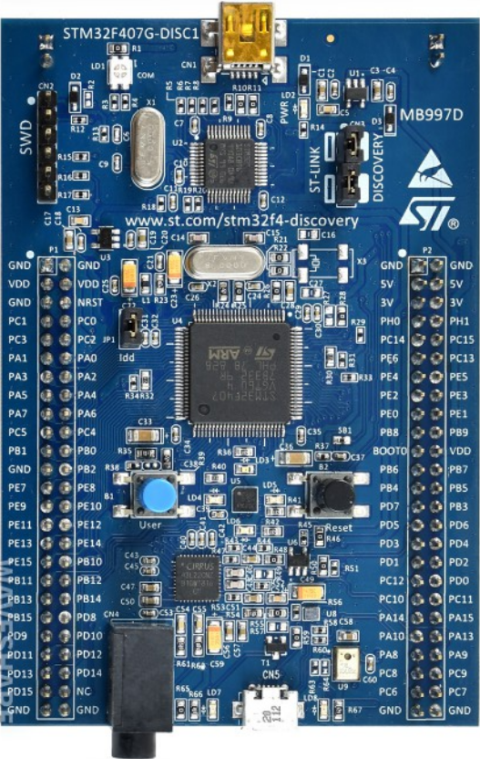
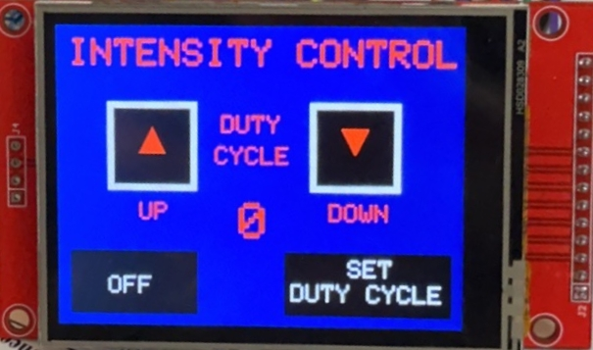
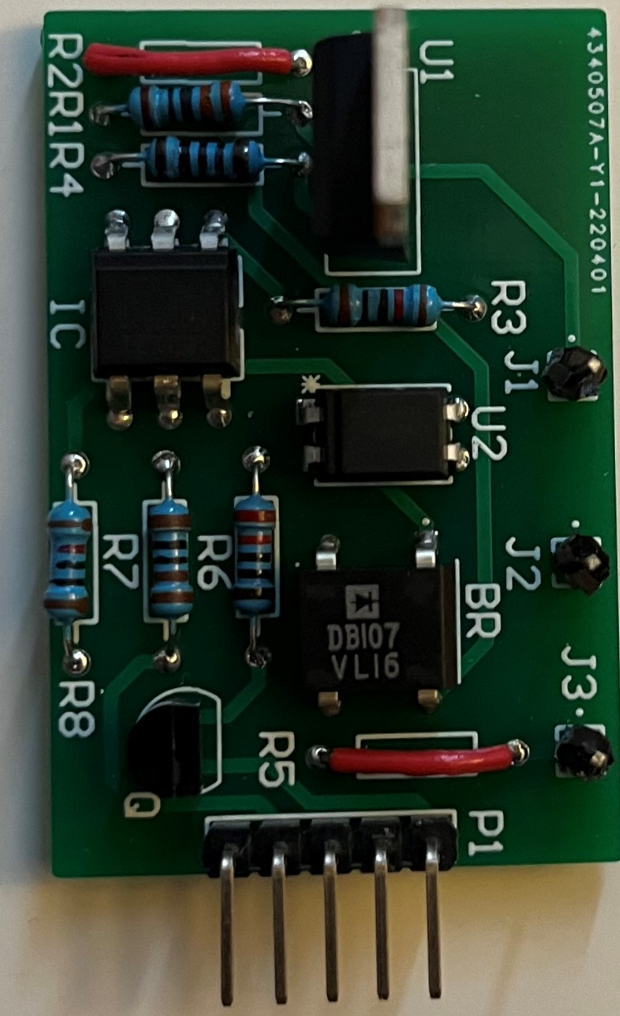
Final System Flow and Hardware Elements
L
N
Phase_In
AC Load
XPT2046_SPI
ZCD_Int
ILI9341_SPI
OPTO_PWM
Phase_Out
Neutral

Slide 4
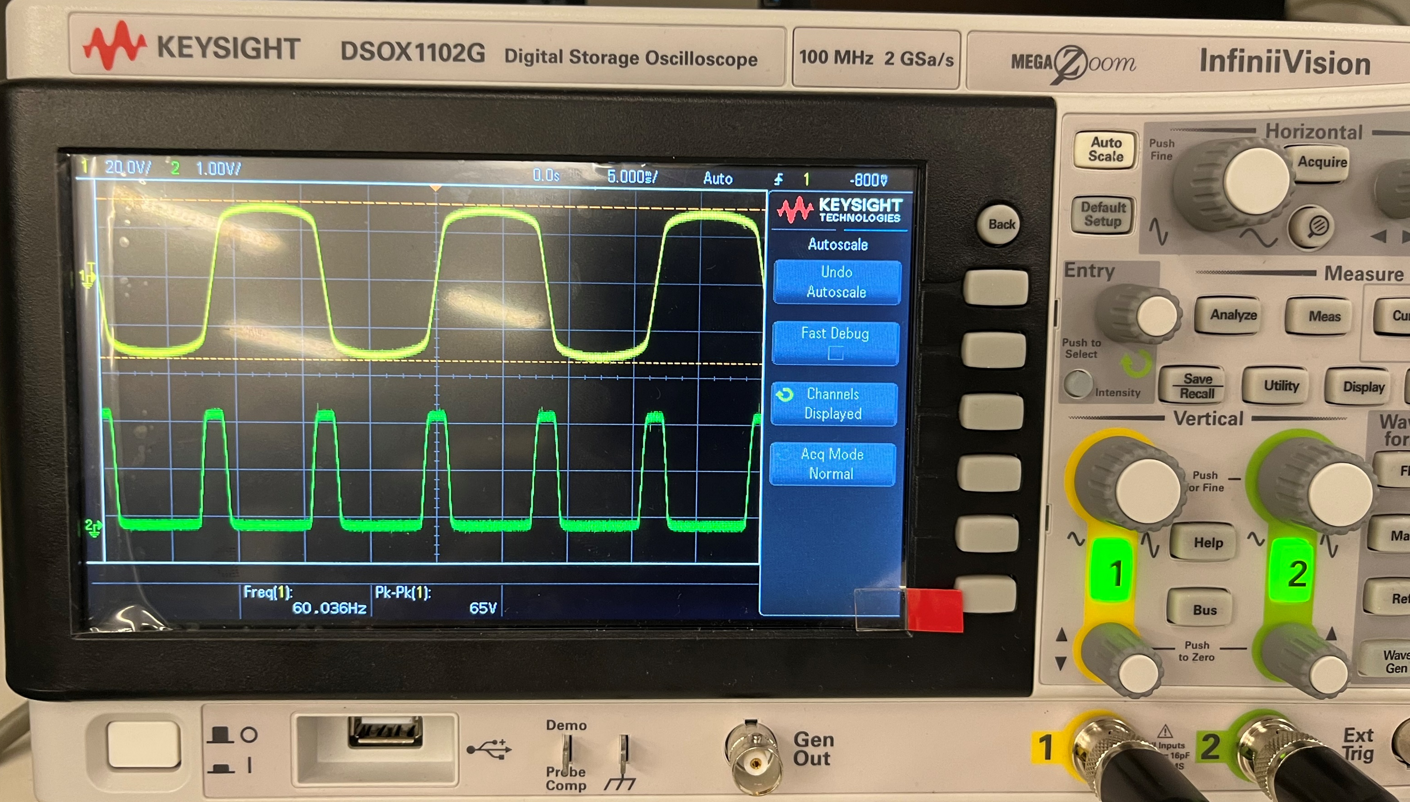
Fall Backs
ZCD does not work with AC mains supply because of DC bias.
The implementation causes flickers on the AC load which is caused due to ZCD failure.
ZCD detection working – tested on function generator

Slide 5
Future Scope
Integrate metering IC (STMP32) to measure the electrical parameters on the load and display it on HMI.
Work on a single board solution for the entire system. Integrate all hardware submodules with the MCU circuit to develop a product-oriented application.

